Slide 2
January 25, 2013
Development & Profit in Project Management:
How Digital Agencies Use Drupal
Presented by James Smith

Slide 3
Pressentor: James Smith
Technical Project Manager at Sensis
Academic Experience:
BA in Economics – University of South Alabama
MA in Financial-Economics and MBA in Finance – University of New Orleans
Ph.D. Studies in Economics – Vanderbilt University
Professional Experience:
Extensive background in healthcare, data management, and business information
PM work in Nashville, New Orleans, San Francisco, L.A.

Slide 4
PM Goals:
Client Satisfaction = Quality Work
Profit = Agile Process

Slide 5
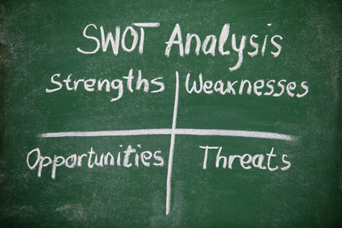

Slide 6
Drupal?

Slide 7
What is Drupal?
Free, open-source web development platform for online content and user communities
Drupal is maintained and developed by a community of 630,000+ users and developers.
Source: http://drupal.org/about
Notes:
This open development model means that people are constantly working to make sure Drupal is a cutting-edge platform that supports the latest technologies that the Web has to offer.

Slide 8
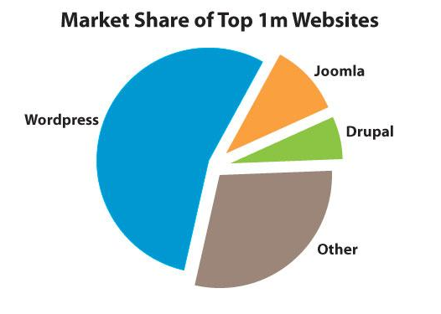
Drupal Market Share
Drupal is used by 7.2% of all the websites whose content management system we know.
This is 2.3% of all websites.
Drupal is used by 24% of government and public sector websites.
Sources: http://w3techs.com/technologies/details/cm-drupal/all/all
http://blog.pixelcrayons.com/wordpress/drupal-popular-among-government-wordpress-among-masses-whats-cooking/
Notes:
WordPress powers 55% of all websites being run using Content Management Systems. Joomla with 8.9% comes second followed by Drupal which has a 7.3% marketing share among CMS usersHowever, when it comes to governmental and public sector websites, Drupal is clearly the king, powering close to 24% of all governmental websites in the world.

Slide 9
Why Drupal?
Open-Source
Drupal was created and released as open-source software under the GNU Public License.
Notes:
That means it’s completely free to download, use, and modify: There are no purchase, license, or maintenance fees…

Slide 10
Why Drupal?
Web Development
Drupal’s default installation is a database-backed web platform with file maintenance tools and a high level of security.

Slide 11
Why Drupal?
Social
Drupal is a multi-user system, letting site visitors log in (as “authenticated” users) or browse the site without doing so (as “anonymous” users).
Notes:
You control their access levels, and can also assign “roles” for multiple permission levels.

Slide 12
Why Drupal?
Content
Drupal both hosts and promotes your content. It can reach out beyond your site to give you a presence on Twitter, Facebook, and in other venues.
Notes:
Drupal’s built-in features also give search engines what they want, improving your web impact automatically.

Slide 13
Why Drupal?
Secure
Drupal is subject to rigorous security testing both by the Drupal community and by security experts around the world.

Slide 14
What companies and sites use Drupal?

Slide 15
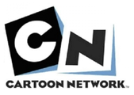
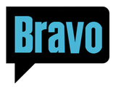
Companies and Sites using Drupal
Source: http://www.drupalshowcase.com

Slide 16
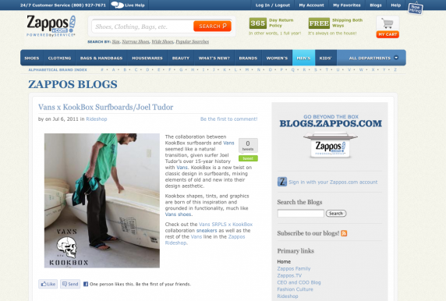
Drupal: Case Studies
Zappos
http://blogs.zappos.com
Zappos.com was founded in 1999 with the goal of becoming the premiere destination for online shoes.
Source: http://www.drupalshowcase.com/drupal-showcase/zappos

Slide 17
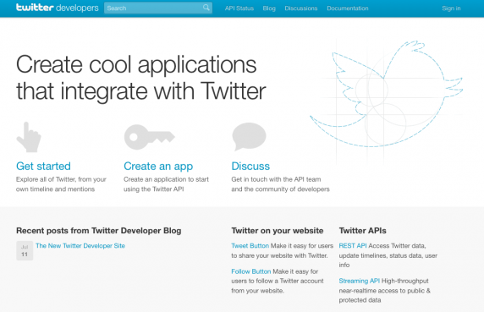
Drupal: Case Studies
Twitter
http://dev.twitter.com
A developer community for the Twitter platform.
With over 750,000 developers building on the platform, Twitter chose to use Drupal to create a new home to support the Twitter community better.
Version of Drupal: Drupal 7
Source: http://www.drupalshowcase.com/drupal-showcase/twitter

Slide 18
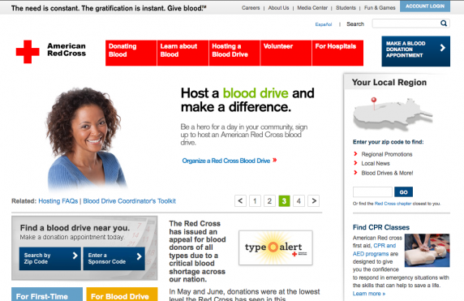
Drupal: Case Studies
American Red Cross
http://www.redcrossblood.org
American Red Cross Biomedical Services plays a critical role in our nation’s health care system.
It is the largest single supplier of blood and blood products in the U.S., collecting and processing more than 40 percent of the blood supply.
Source: http://www.drupalshowcase.com/drupal-showcase/american-red-cross

Slide 19
Project Management

Slide 20
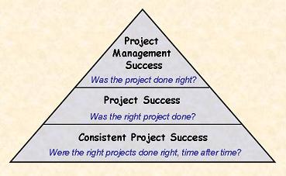

Slide 21
If you don’t know where you’re going, you probably will end up somewhere else.”
~ Laurence J. Peter.

Slide 22
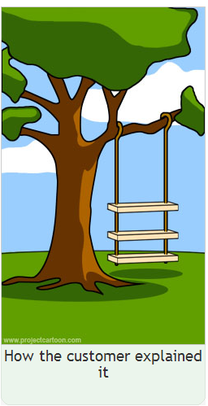
How Projects Often Work

Slide 23
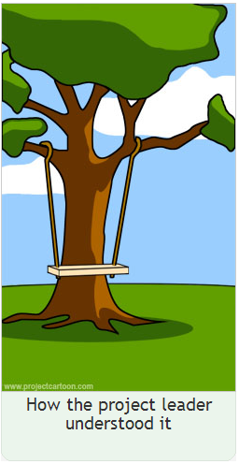

Slide 24
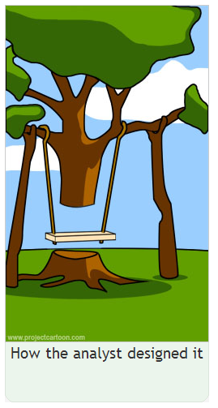

Slide 26
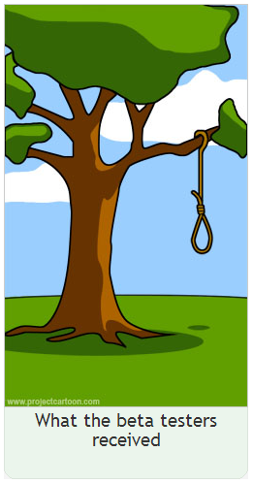

Slide 27
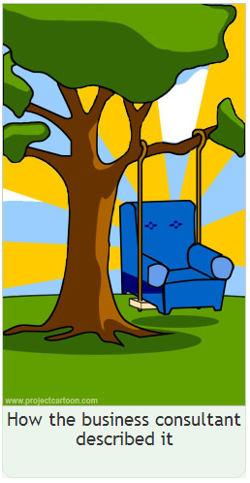

Slide 29
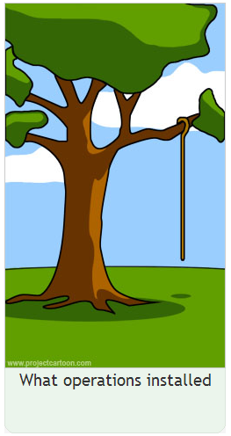

Slide 30
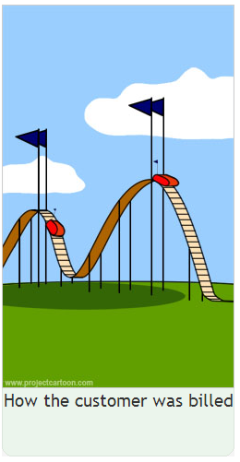

Slide 33
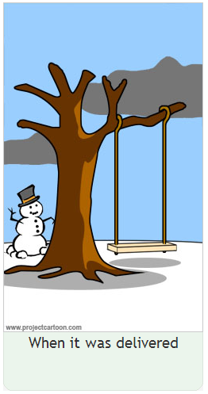

Slide 34
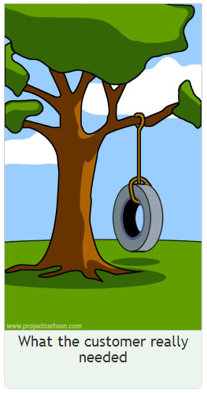

Slide 35
What is Agile?

Slide 37
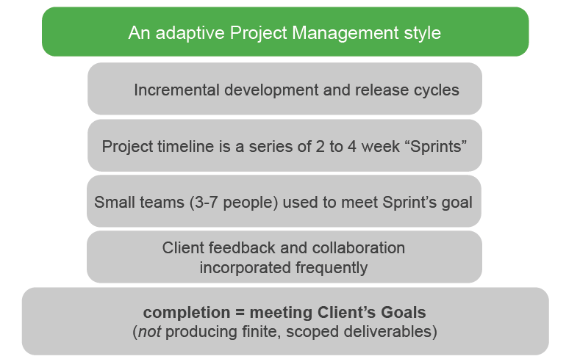
What is Agile?
Source: Sensis Agile Foundation Training from Digital Onion.

Slide 38
Why Agile?
Agile = Clear Communication
Clear expectations
No more over-promised & under-delivered projects
Successful projects
Long-term, successful client relationships
Notes:
Agile is flexibility. Not getting locked into a static process, to have the ability to

Slide 39
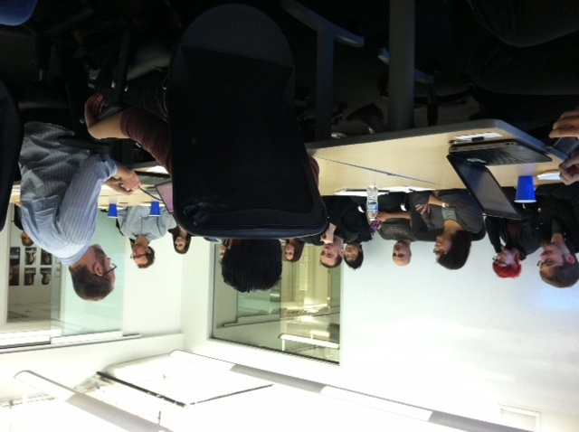
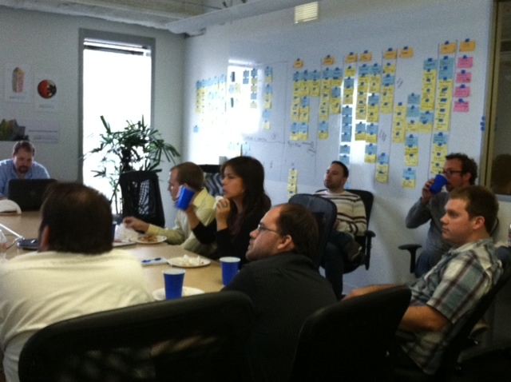
Communication
* Based on research by Albert Mehrabian, Ph.D., Professor Emeritus, UCLA.

Slide 40
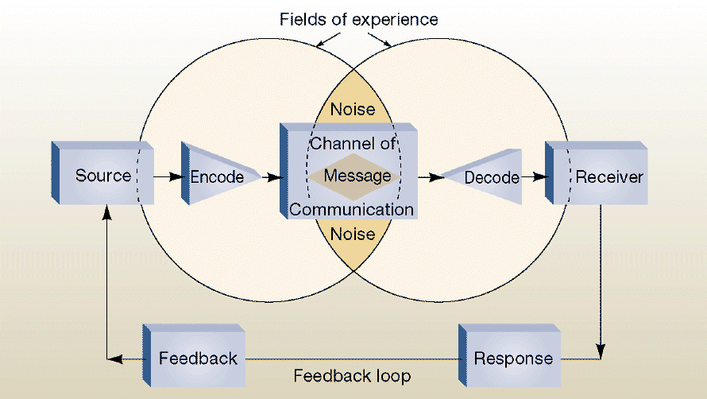
Communication Process

Slide 41
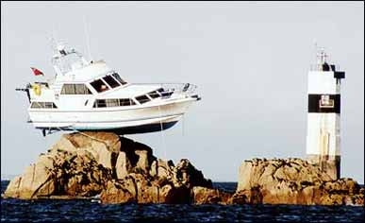
This results from “NOISE” in the Communication Process

Slide 42
Manage
the
GAP!

Slide 43
…Or else your clients
will look like this…

Slide 44
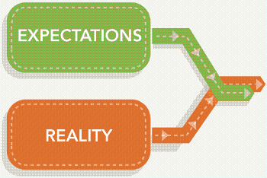

Slide 48
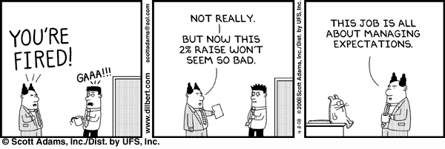

Slide 49
Waterfall
Waterfall
Waterfall final product after go-live feedback
Waterfall final product
Agile
Source: http://www.windarooci.com/service_list/view_service/4
Notes:
Waterfall software development is a sequential software development model in which development is seen as flowing steadily downwards (like a waterfall) through the phases of requirements analysis, design, implementation, testing (validation), integration, and maintenance. Agile promotes development iterations throughout the life-cycle of the project. Agile methods emphasize face-to-face communication over written documents.

Slide 50
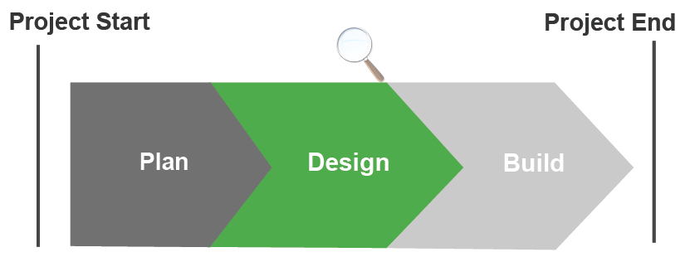
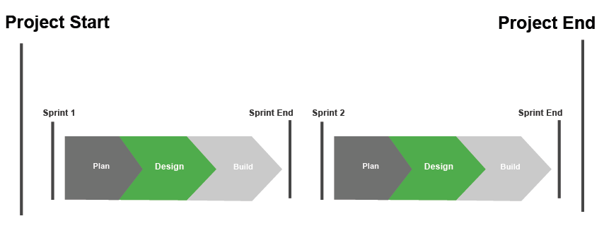
Waterfall vs. Agile
Waterfall
Agile
Source: Sensis Agile Foundation Training from Digital Onion.
Notes:
More than half of the Waterfall Projects go over budget or over duration. This happens despite this fact being known, the larger/longer the project the worse it gets. And adding people rarely helps… Waterfall is predictive: it’s core assumption is that you can accurately and precisely plan and predict how to achieve an outcome of a large and complex project. The larger and more complex, the more likely that this is not true

Slide 51
Project Management: Statistics
The Standish Group research:
31.1% of projects will be cancelled before they ever get completed.
52.7% of projects will cost 189% of original estimates.
16.2% of software projects are completed on-time and on-budget.
In the larger companies, the news is even worse: only 9% of their projects come in on-time and on-budget.
Source: Sensis Agile Foundation Training from Digital Onion.

Slide 52
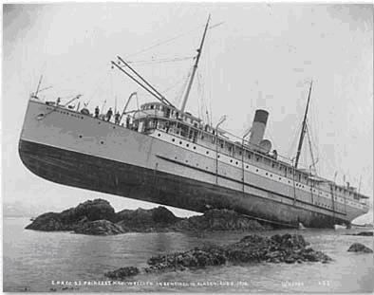
Waterfall frequently
results like this

Slide 53
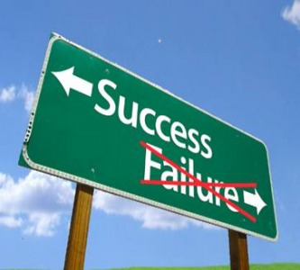

Slide 54
Agile
Agile Iteration 3
Agile Iteration 2
Agile Iteration 4
Agile
Agile Iteration 1
Agile final product: What the client wanted
Source: http://www.windarooci.com/service_list/view_service/4
Notes:
Waterfall software development is a sequential software development model in which development is seen as flowing steadily downwards (like a waterfall) through the phases of requirements analysis, design, implementation, testing (validation), integration, and maintenance. Agile promotes development iterations throughout the life-cycle of the project. Agile methods emphasize face-to-face communication over written documents.

Slide 55
AGILE Methodologies
Improve the chances
for Clients like this…

Slide 56
Why Agile?
Agile Values
Individuals and interactions > processes and tools
Working software > comprehensive documentation
Customer collaboration > contract negotiation
Responding to change > following a plan
Team Growth > individual success
Notes:
That is, while there is value in the items on the right, we value the items on the left more

Slide 57
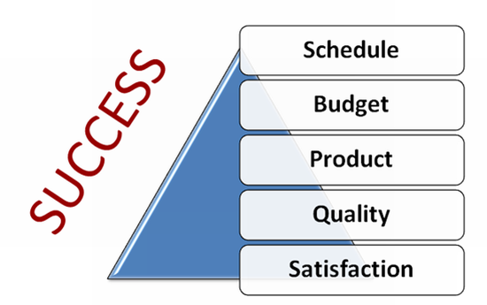

Slide 58
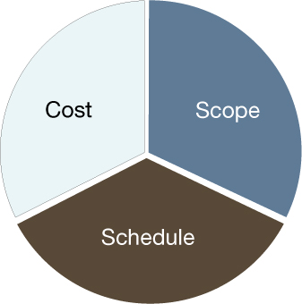

Slide 59
SENSIS

Slide 60
Notes:
We opened our doors in 1998 (as Focus Multimedia).
We got our start building websites and have expanded into a full service advertising agency, helping our clients take advantage of the fundamental changes taking place in the marketing world — the emergence of digital technologies, expanded multiculturalism, and the transformative impact of social media.

Slide 61
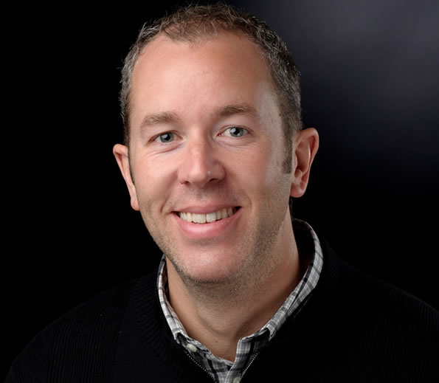
Jose Villa
President and Founder
Vision for the Sensis: leveraging technology to bring analytical rigor to the advertising business.
A thought-leader in multicultural advertising
Founder of TuRumbo.com
Focus Multimedia (Website Development Firm)
Sensis (Full-service advertising agency)
Notes:
Before launching Sensis, Jose Villa was a business analyst and technologist. It is this perspective that informed his vision for the Sensis: leveraging technology to bring analytical rigor to the advertising business.
A thought-leader in multicultural advertising, Jose has been at the forefront of a new cross-cultural approach to marketing that factors multicultural insights into general market campaigns.
Prior to Sensis, Jose was the founder of the pioneering Hispanic dot com TuRumbo.com.

Slide 62
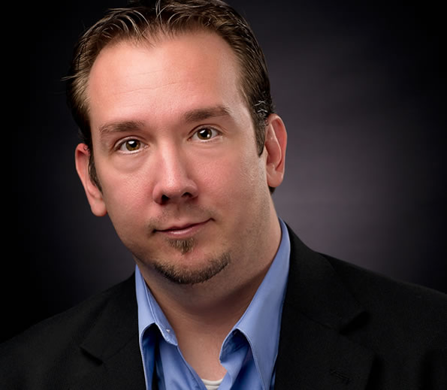
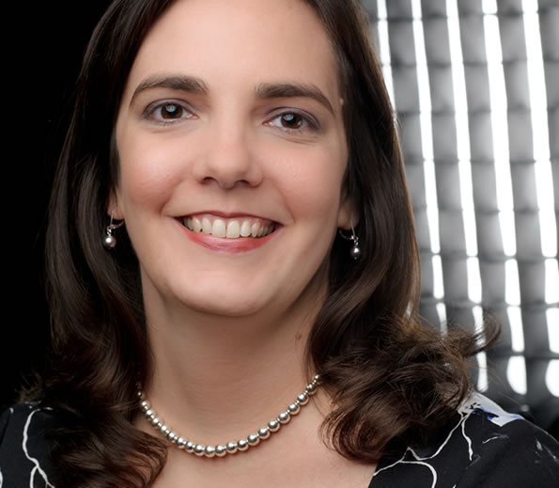
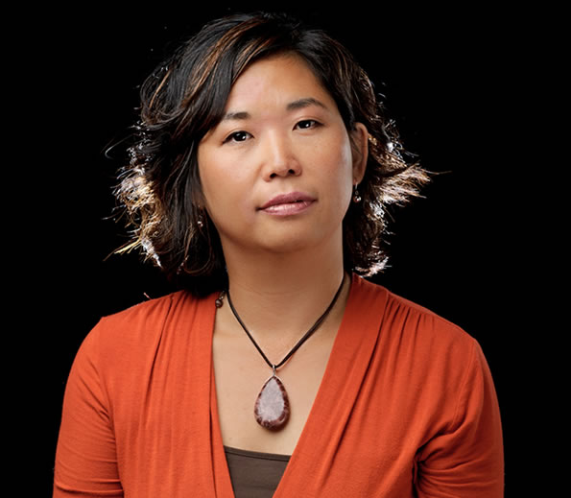
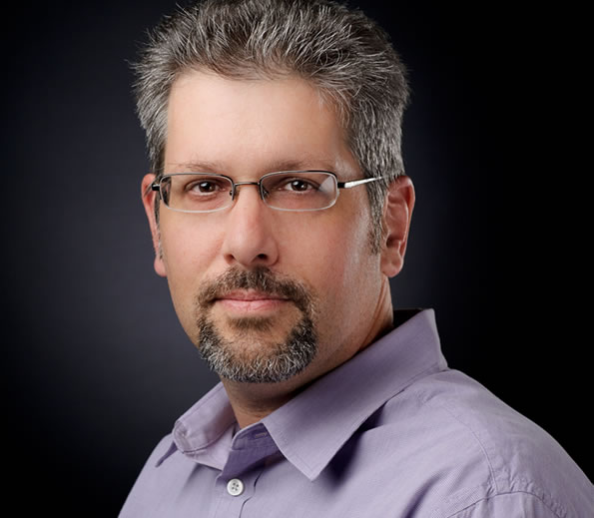
Agency Leaders
President
Jose
Media
Account
Creative
New Business
Technology
Rick
Melissa
Roy
Gloria
Wade

Slide 63
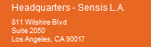
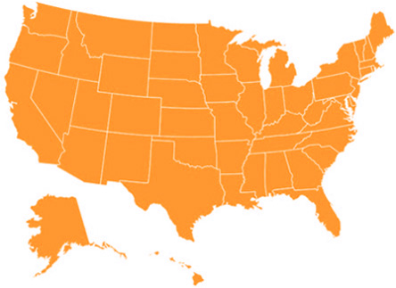
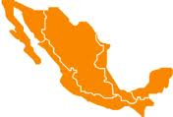
OFFICES:
Notes:
Sensis is headquartered in LA and has another office in D.C.

Slide 64
Agency Profile
Advertising & digital agency
43 employees
$12 million in revenue (2012)
15 years in business
Independent, minority-owned

Slide 65
Sensis’ clients:

Slide 66
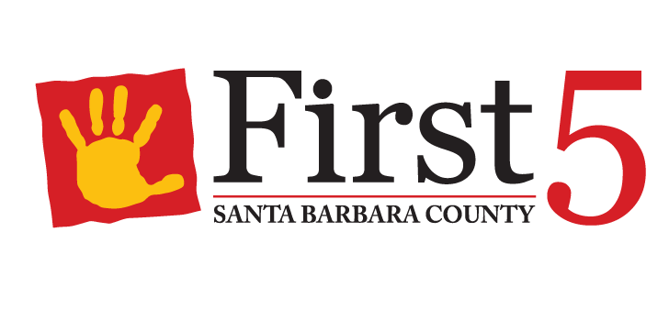
Past Drupal Projects:
Current Drupal Projects:

Slide 67
SENSIS:
Agile Process

Slide 68
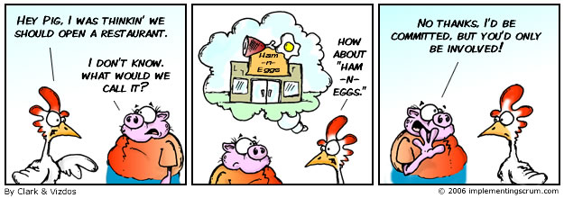
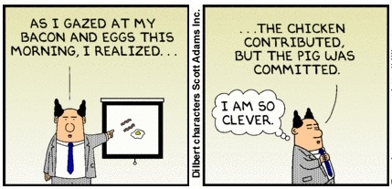

Slide 69
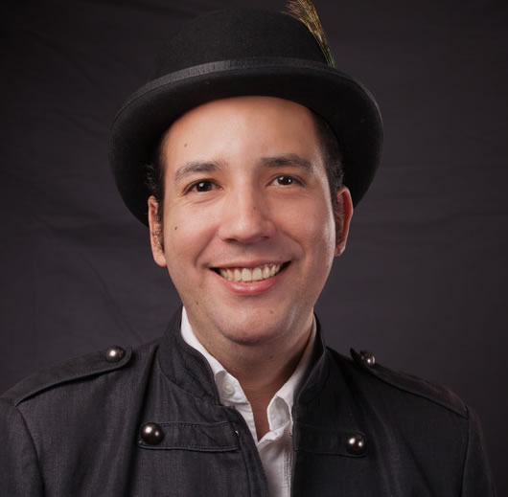
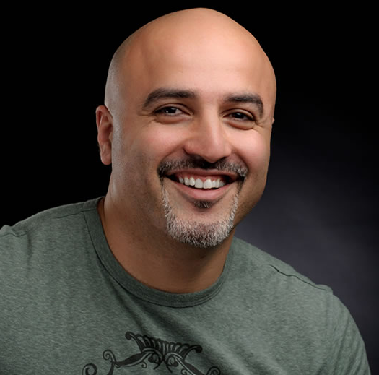
Drupal Projects: Team Structure
Developers (F/E & B/E)
Project Manager
Eric
Piper
James
UX & Design
Alberto
Manaf

Slide 70
Project Management: Check-In Daily
Have I met your expectations today?
Did you get what you needed (from me)?
Did that actually do what you wanted/need it to do?
What do you want or think you need next?
When do you need that by?

Slide 71
Drupal Projects at Sensis: The Process
Contract Finalized for Drupal Project
Creation of Project Team based on best fit of available resources
Production starts with Agile
Project is divided into sprints and phases
Sprint 1 Planning Meeting
Notes:
Contract can be fixed-price or cost-plus… (With a fixed-price contract, if you haven’t scoped the work properly, you aren’t going to make a profit and end with a potential)
Project begins at Sprint 0…
During the Sprint 1 Planning Meeting, the client determines the Definition of Done and Project Goals…
Content Strategy is used in all Drupal projects at Sensis

Slide 72
Agile Work Flow
GET READY
BACKLOG GROOMING
REMOVE IMPEDIMENT
DONE
DELIVER VALUE
Sprint ‘N’
PRODUCT BACKLOG
Sprint 3
Sprint 2
Sprint 1

Slide 73
Drupal Projects at Sensis: The Process
Sprint 0 Planning Meeting
Jan. 28
Sprint 0
Sprint 1 Planning Meeting
Feb. 11
Sprint 1
Feb. 19
Mid-Point Review
Sprint 1 Review = Sprint Retrospective
Feb. 26
Sprint 2 Planning Meeting
Feb. 26
Sprint 2
Mid-Point Review
Sprint 2 Review
Notes:
Project begins at Sprint 0…
During the Sprint 1 Planning Meeting, the client determines the Definition of Done and Project Goals…

Slide 74
Sprint Retrospective
Good – Bad – (Could Do) Better – Best
Scoring:
Progress
Schedule
Scope
Team Satisfaction
Client Satisfaction
Quality

Slide 75
Past Drupal Projects at Sensis

Slide 76
Past Drupal Projects at Sensis
Microsite
Website Redesign
Mobile Website
Microsite

Slide 77
Sempra Energy: Microsite Design
Objective:
Create a microsite showcasing major renewable energy technologies in consumer-friendly terms, in addition to displaying Sempra's own involvement in renewable energy initiatives.
Solution:

Slide 78
United Healthcare: Mobile Website
Objective:
Tasked with creating a bilingual mobile site for United Healthcare we developed a means for easily finding common healthful related content as well as convenient health care guidance.
Solution:
m.uhclatino.com

Slide 79
United Healthcare: Mobile Website

Slide 80
United Healthcare: Mobile Website

Slide 81
Ameritas College: Website Redesign
Objective:
Launch a site that introduced its unique mission to serve the academic needs of bilingual students.
Solution:
To best represent the nurturing environment of Ameritas College, we built a site that emphasized the support structures available to potential students, from registration, enrollment, financial aid, and academic assistance.

Slide 82
Ameritas College: Website Redesign
01
Website Redesign & CMS Integration
Ameritas College / Brand University

Slide 83
L.A. Care Health Plan D5 to D7
01
Website Redesign & CMS Integration
L.A. Care Health Plan

Slide 84
http://duals.lacare.org/
L.A. Care DUALS
About the Company:
L.A. Care is the nation’s largest health care management company with over 1 million members
Objective:
Create a microsite to educate the community and healthcare providers in L.A. counties to Duals, a new L.A. Care health plan

Slide 85
Website Redesign & CMS Integration
San Diego Gas & Electric

Slide 86
Website Redesign
FEMA

Slide 87
Website Redesign & CMS Integration
Association of Hispanic Advertising Agencies

Slide 88
Website Design & CMS Integration
Cooperative of American Physicians

Slide 89
Website Design & CMS Integration
The Trevor Project

Slide 90
Website Design & CMS Integration
Versailles

Slide 91
Connect with Sensis:
Facebook facebook.com/sensisagency Twitter twitter.com/sensisagency
YouTube youtube.com/sensisagency
LinkedIn linkedin.com/company/sensis_2
Learn more about Sensis:
sensisagency.com

Slide 92
James Smith
James.Smith@SensisAgency.com

